Slide 1

Profiling the Chinese Participants in Psychological Science: Non-WEIRD but Not Representative
2027.07.13
华中师范大学研究生会

Slide 2
Research background
Henrich et al. (2010) posit the WEIRD problems to draw researchers’ attention to the severe lack of participants. Regrettably, this issue has barely to changed in past two decades (Sanches de Oliveira & Baggs, 2023). To solve this problem, scholars have sought to collect more participants from non-WEIRD regions.
Nevertheless, a critical unresolved question remains: whether participants recruited from non-WEIRD regions can represent their local population.

Slide 3
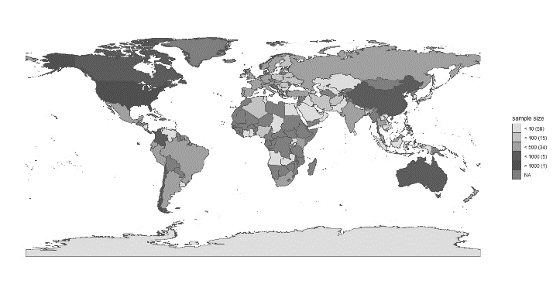
Method
中国临床心理学
心理学报
心理与行为研究
心理科学
心理发展与教育
...
1000 Chines journal articles
Code manual
Data source
Article basis info
Subjects info
Other important info
27 large-scale International collaborations projects
华中师范大学研究生会

Slide 4
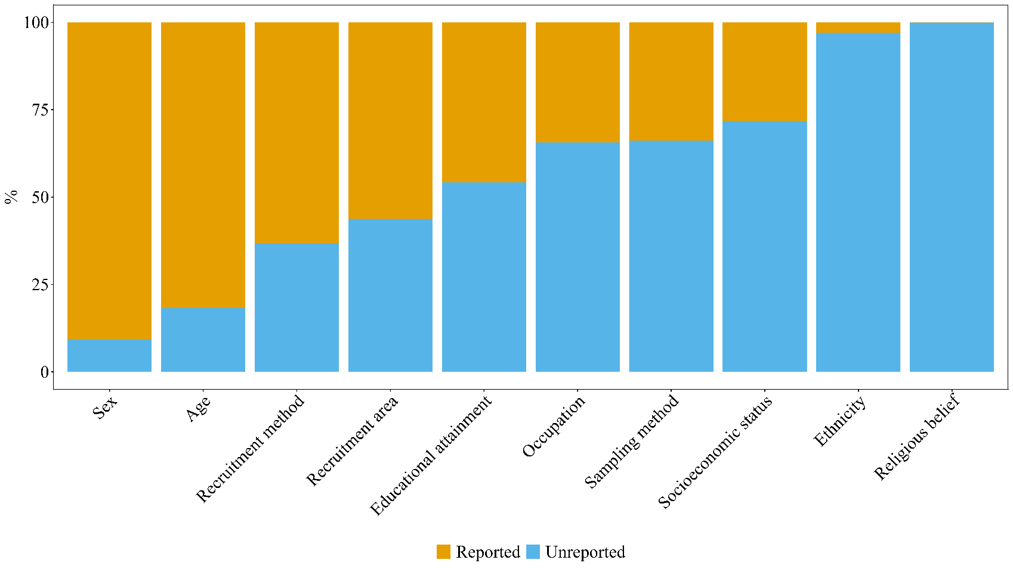
Reports of Chinese journal
华中师范大学研究生会

Slide 5
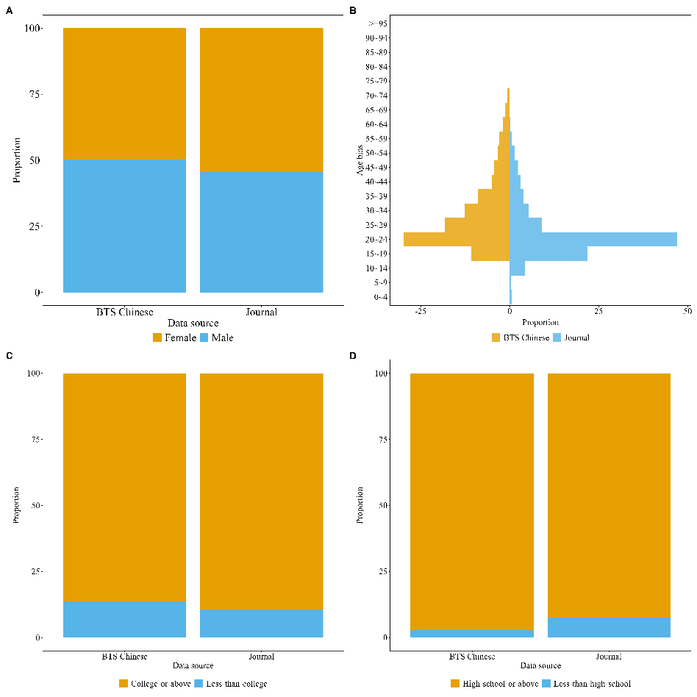
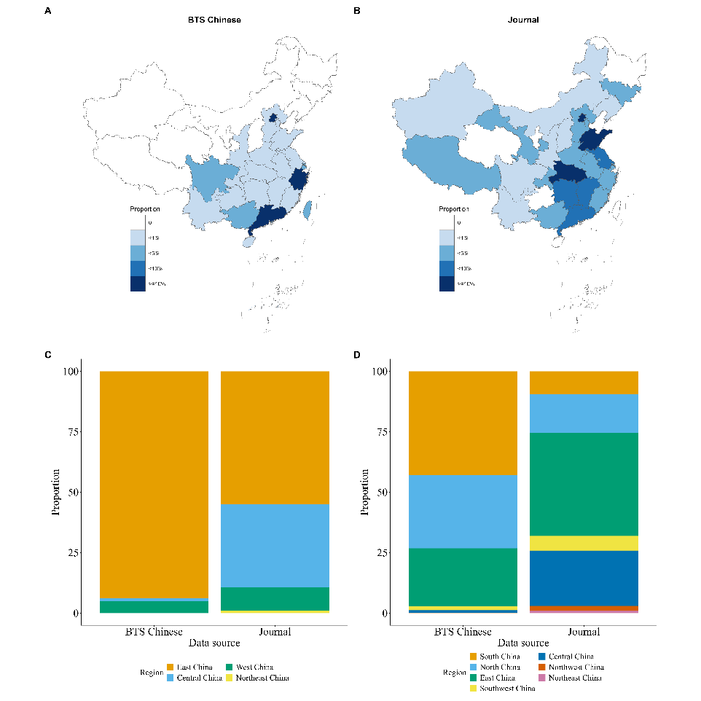
Chinese journal vs large-scale international collaborative projects
华中师范大学研究生会

Slide 6
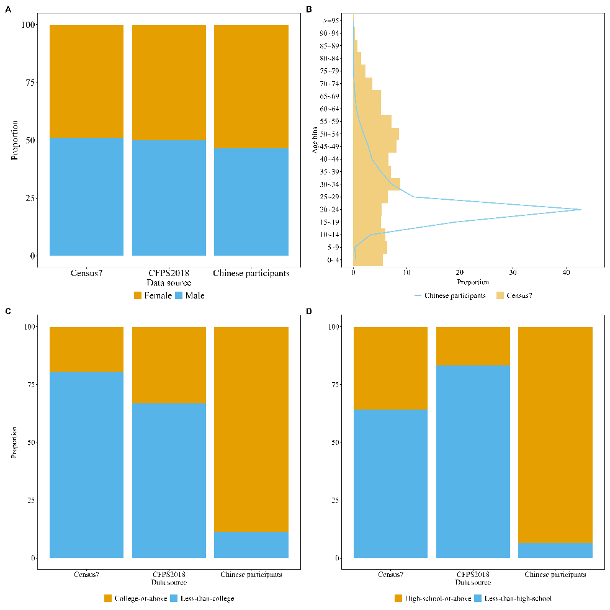
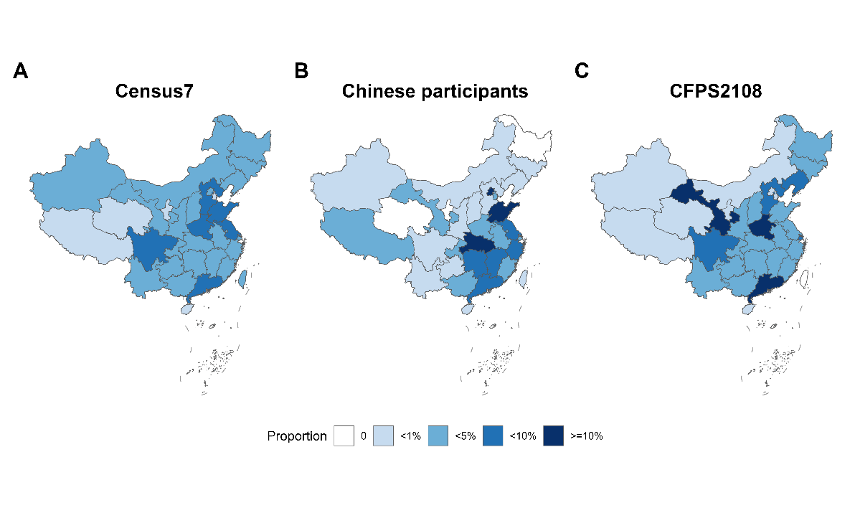
Chinese participants vs Census/CFPS
华中师范大学研究生会

Slide 7
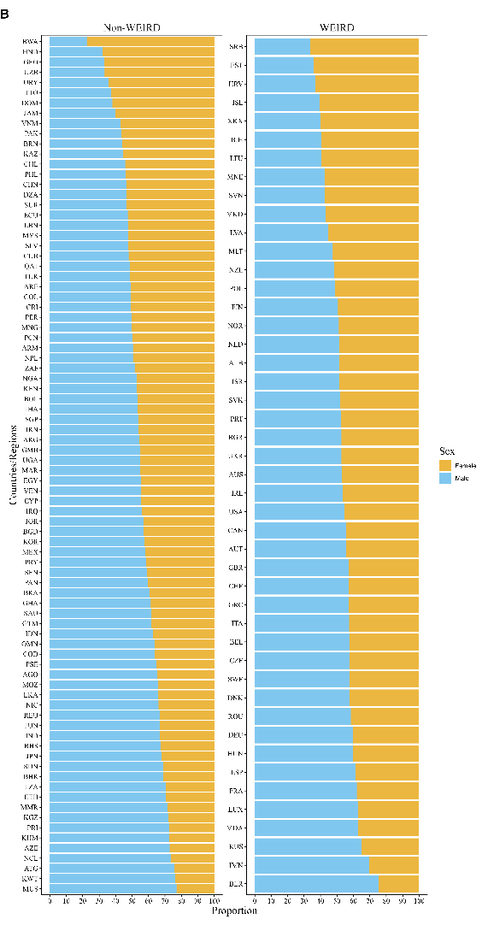
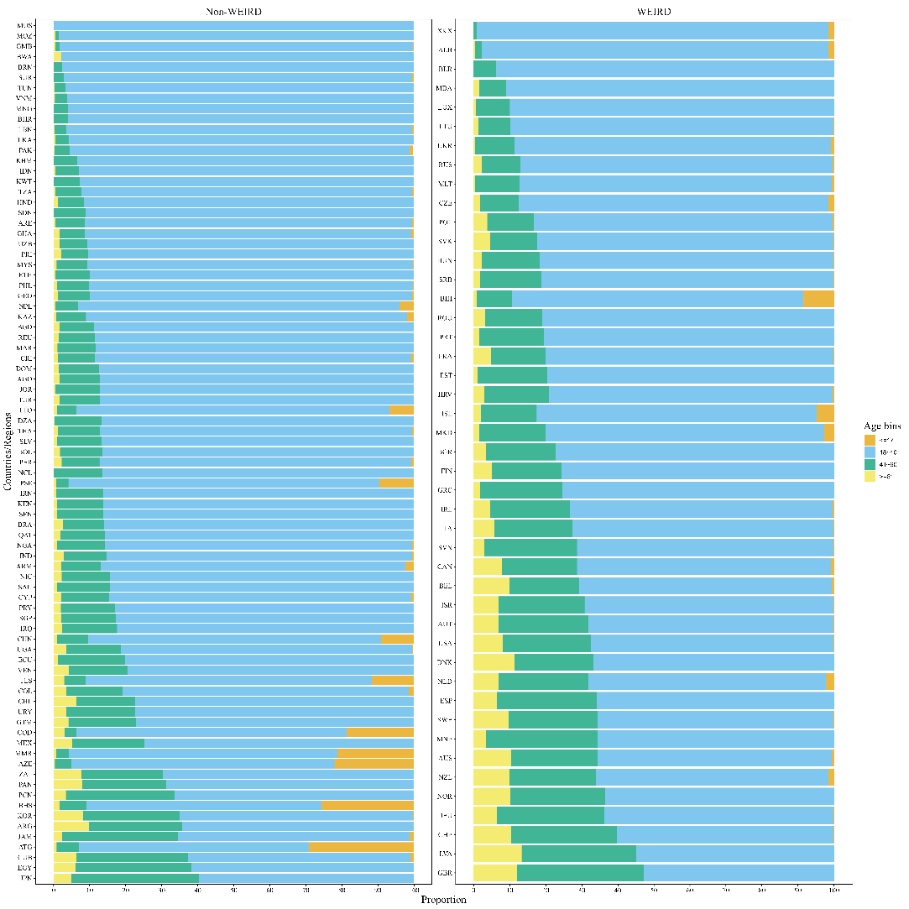
Chinese participants vs Other countries or regions
华中师范大学研究生会

Slide 8




Research progress
PCI-RR
Stage1 acceptance
2023.04.03
25th NACP
2023.10.14
2021.03
2021.05
2021.09
2025.10.6-8
华中师范大学研究生会

Slide 9
Research progress
PCI-RR Stage2
2026.2.19
Revision round #2
华中师范大学研究生会

Slide 10
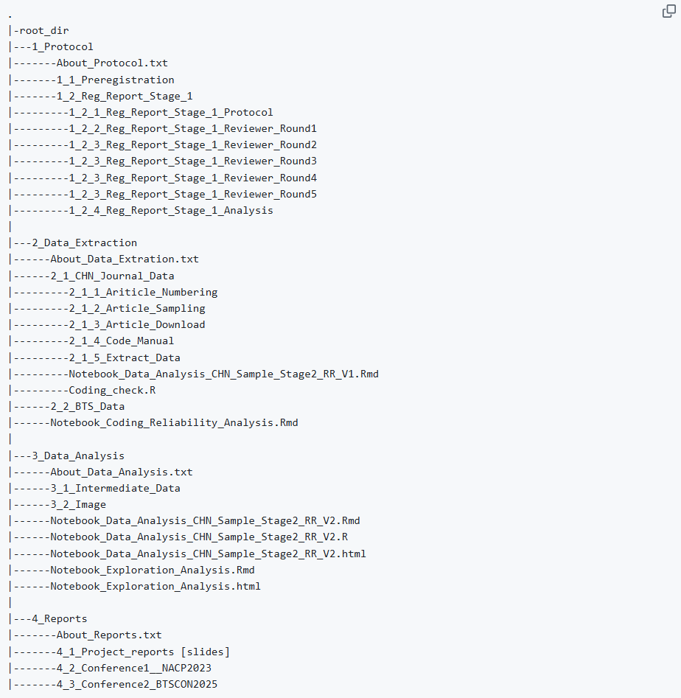
Folder structure
华中师范大学研究生会

Slide 11


Github commit
华中师范大学研究生会

Slide 12
感谢大家倾听！

